Slide 1

Phishing Website EDA
Ghadeer Ali Alghamdi

Slide 2
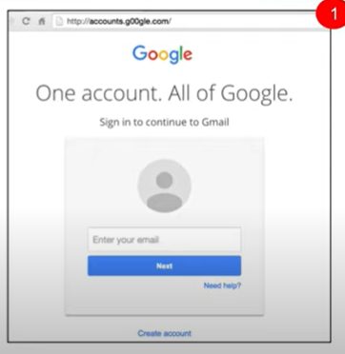
What do you think?

Slide 3
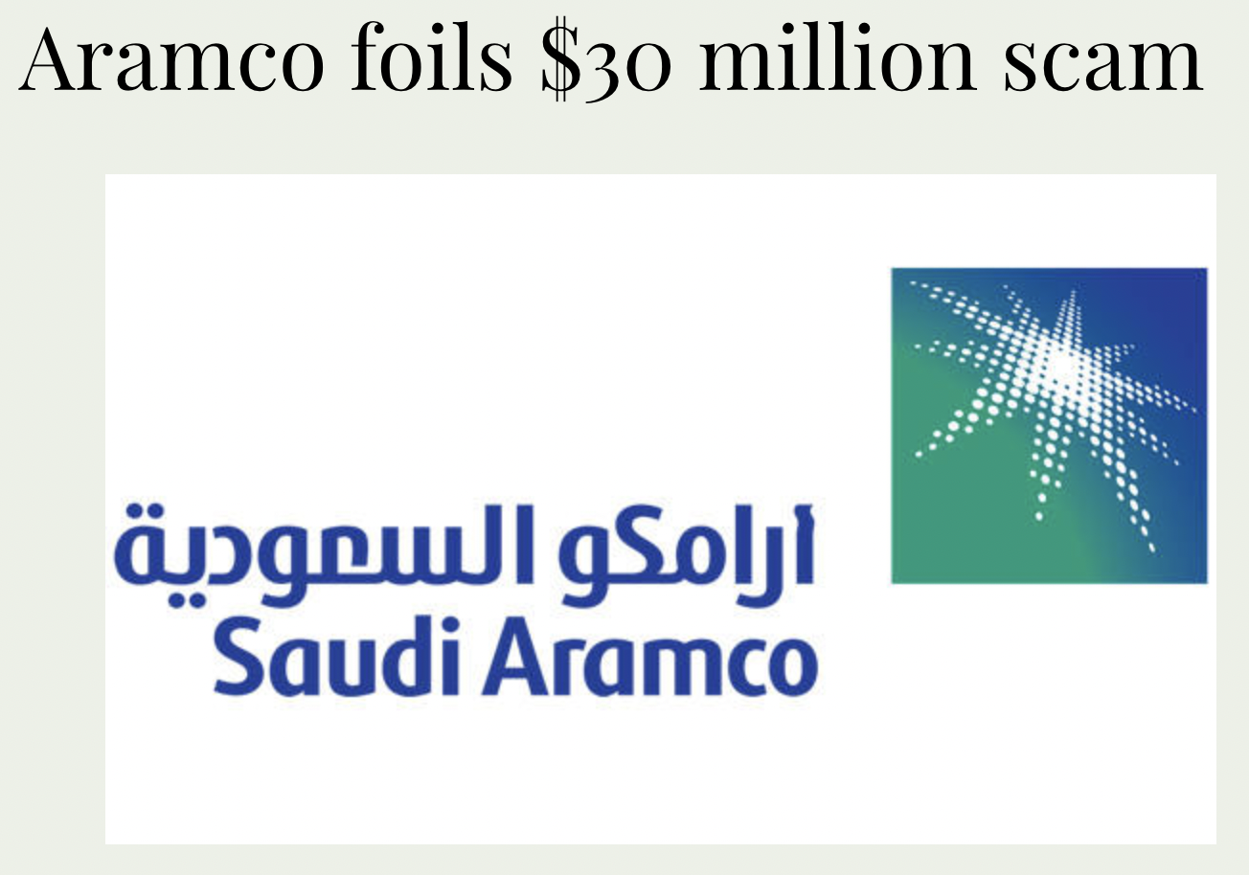

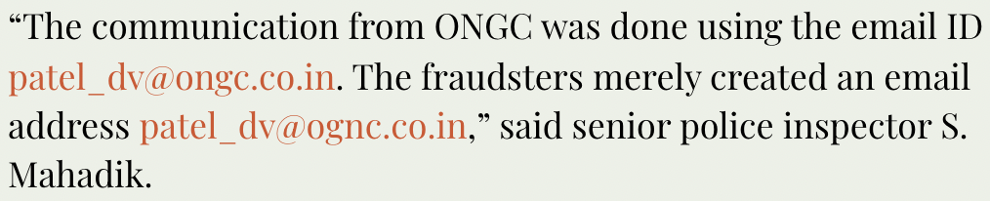
Aramco and ONGC

Slide 4
Outline
Phishing Websites EDA
Problem Statement
01
04
Data Cleaning
Data Collection
02
05
Visualization and Findings
03
Data Extraction
03
06
Future Work
conclusion

Slide 5

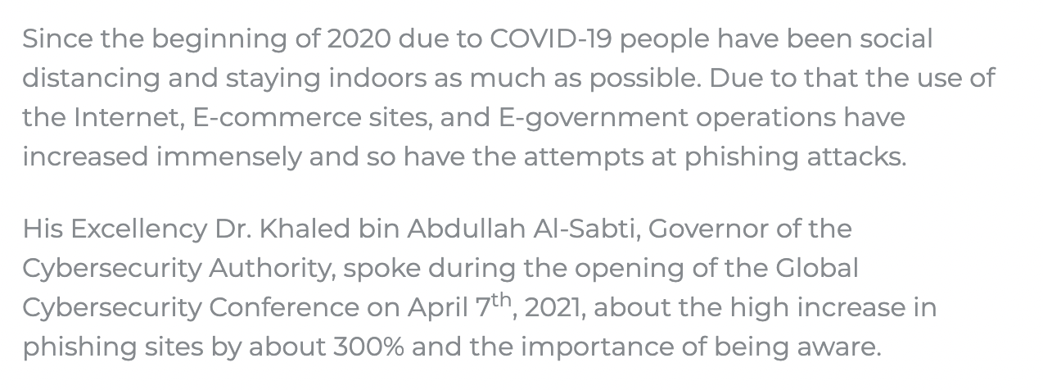
Why Phishing Websites?
Problem Statement

Slide 6
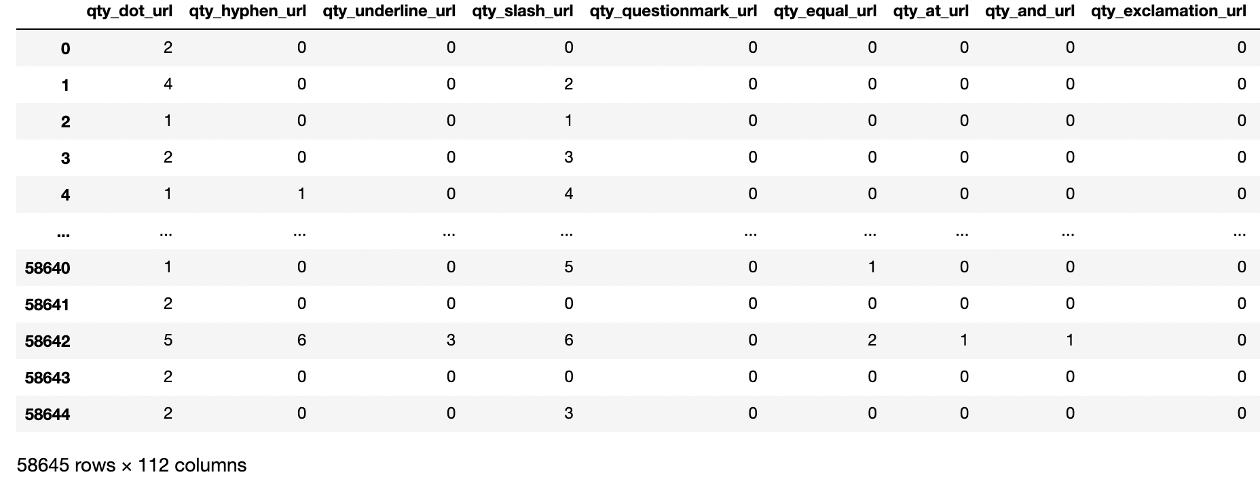
Data Collection
1. Phishing Websites Dataset from sciencedirect.com

Slide 7
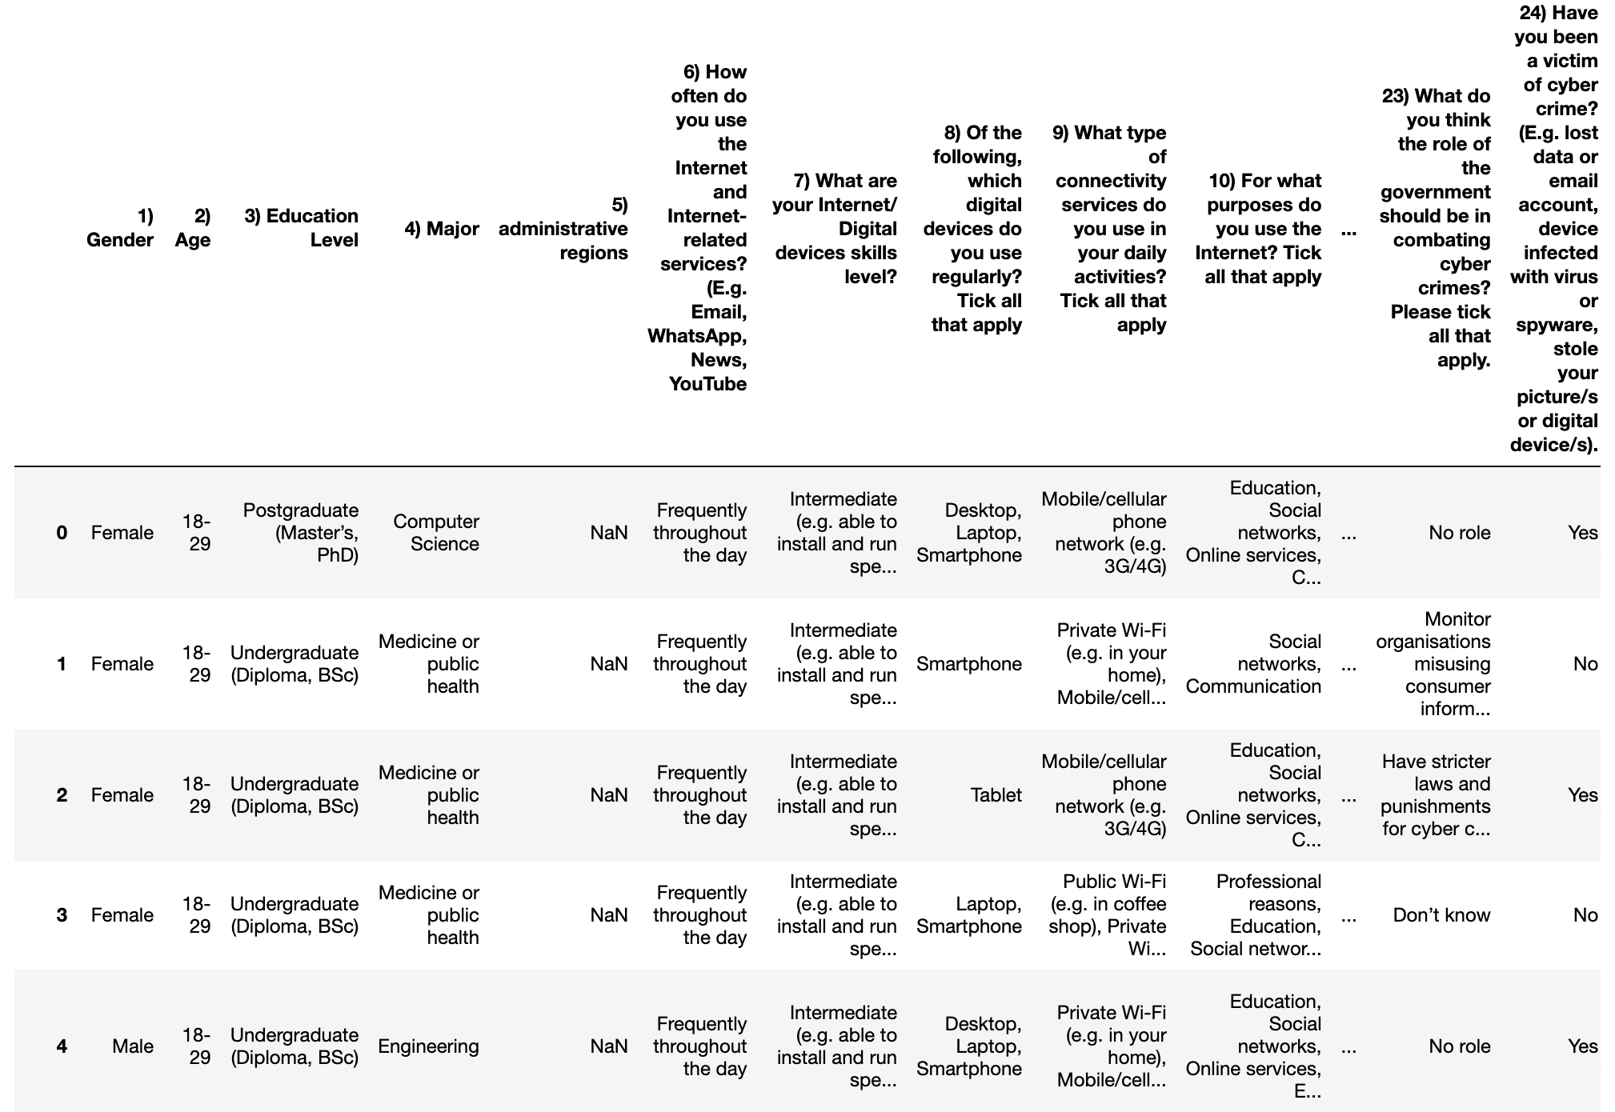
Data Collection
2. Cybercrime Awareness among Saudi Nationality from sciencedirect.com

Slide 8
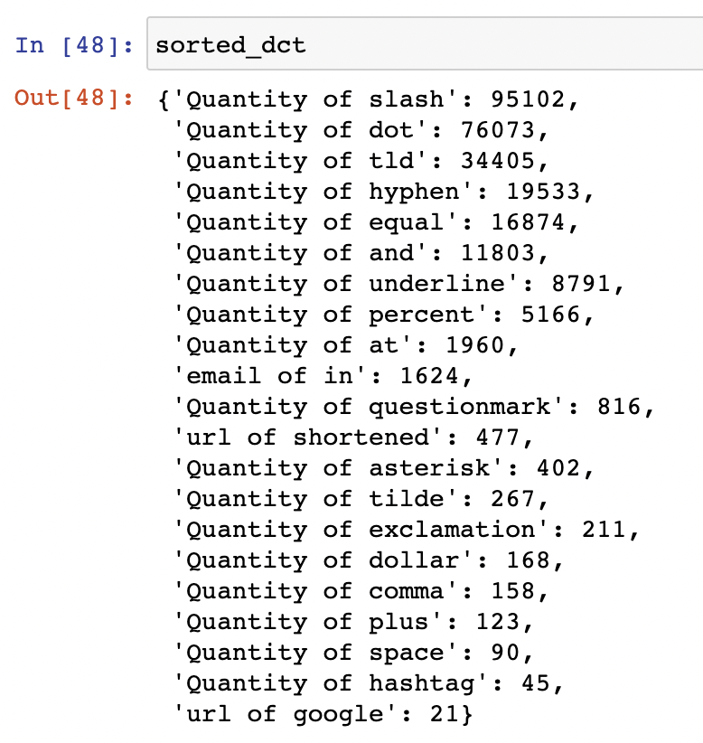
Data Extraction
1. Phishing Websites Dataset Extraction

Slide 9
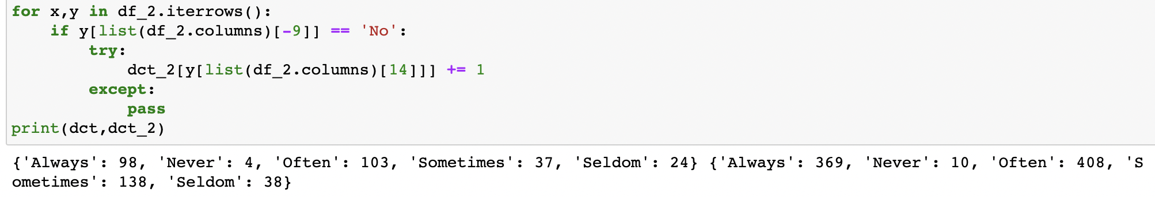
Data Extraction
2. Cybercrime Awareness Datatset Extraction

Slide 10
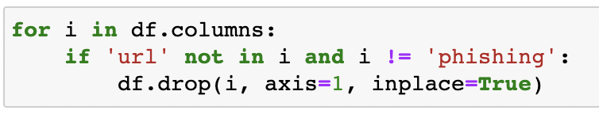
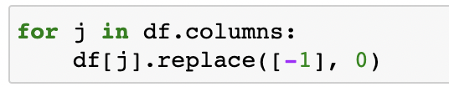
Data Cleaning
1. Drop
2. Replace
2. Rename

Slide 11
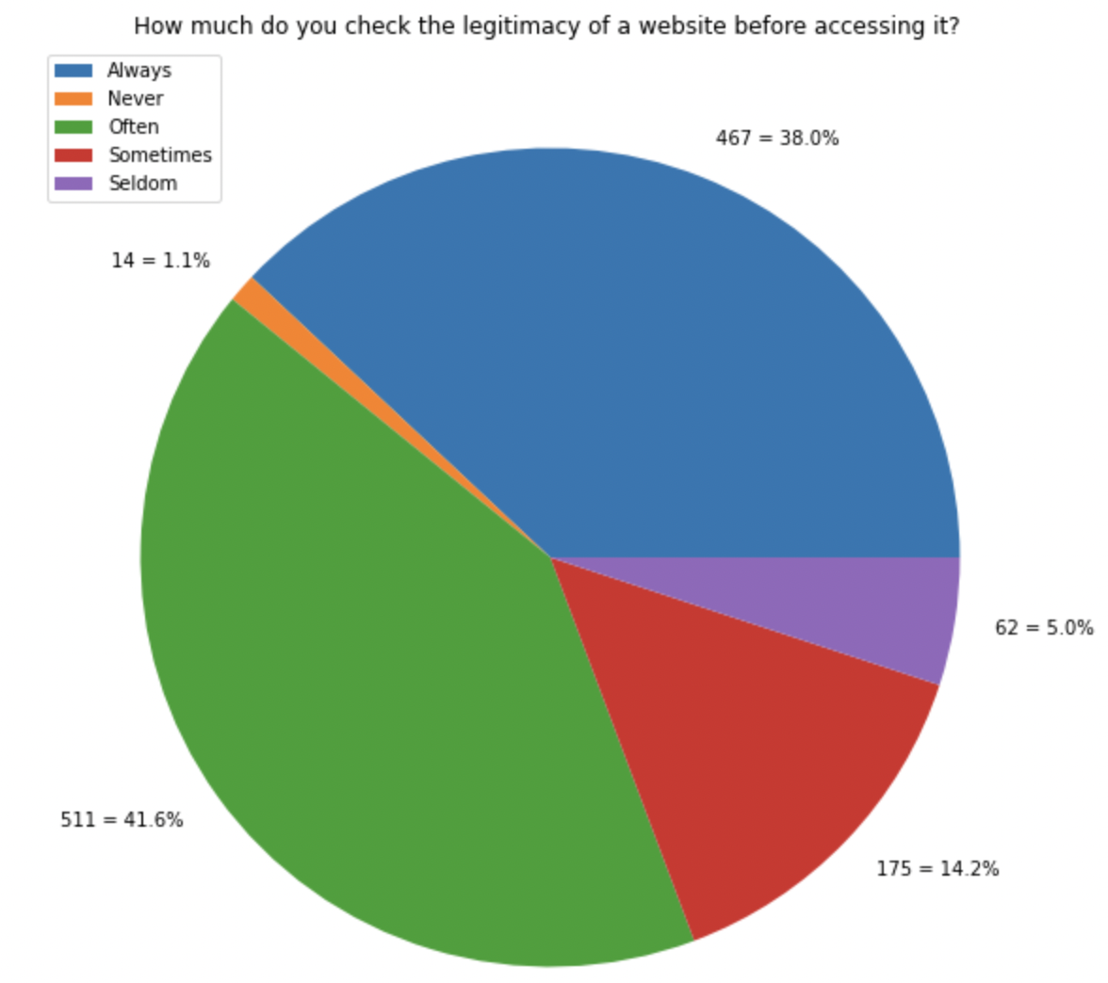
Visualization and Findings
Cybercrime Awareness

Slide 12
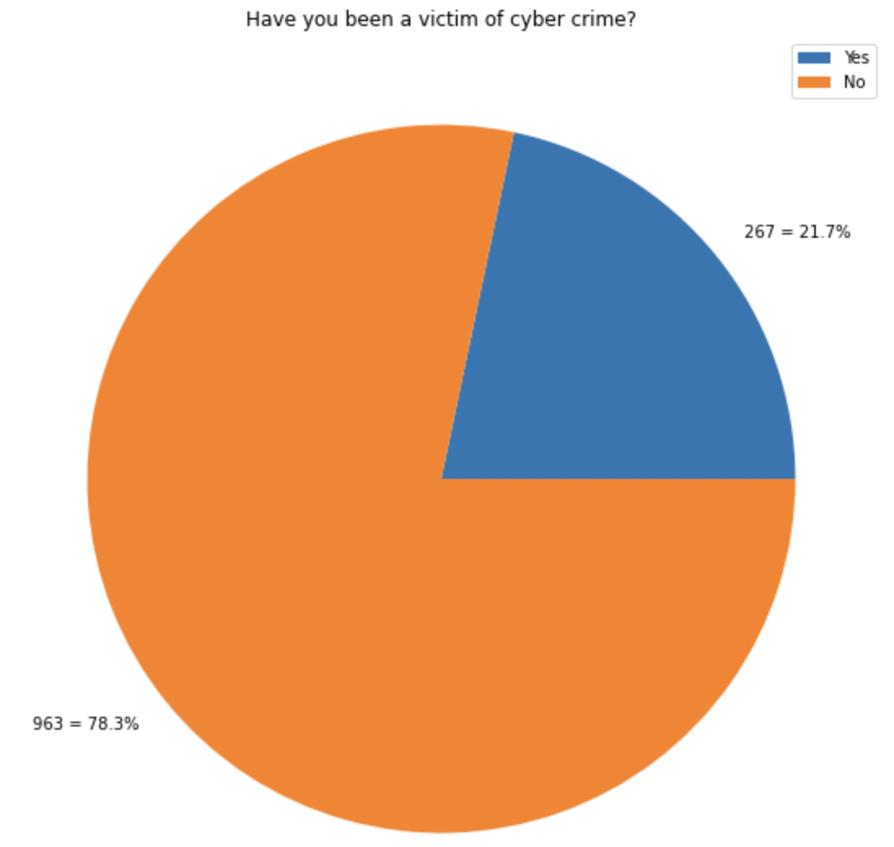
Visualization and Findings
Cybercrime Awareness

Slide 13
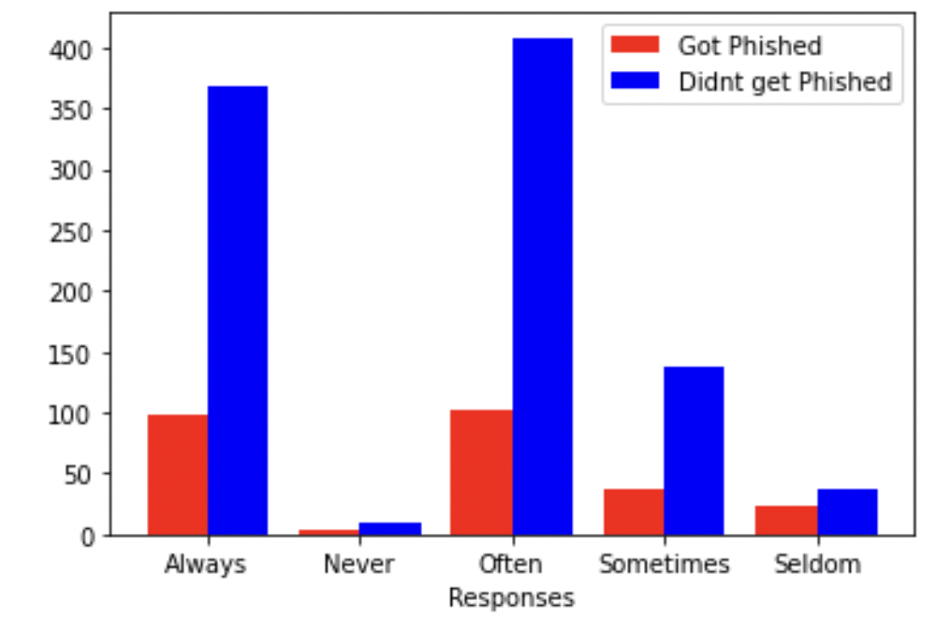
Visualization and Findings
Cybercrime Awareness

Slide 14
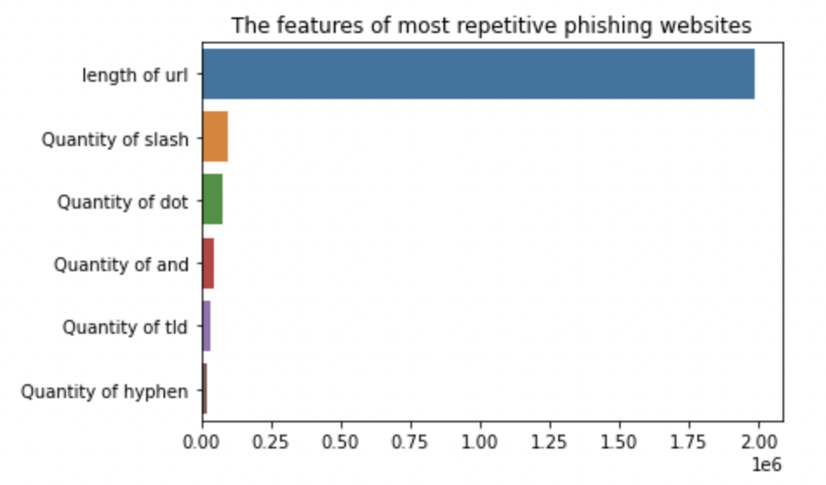
Visualization and Findings
Phishing Websites

Slide 15
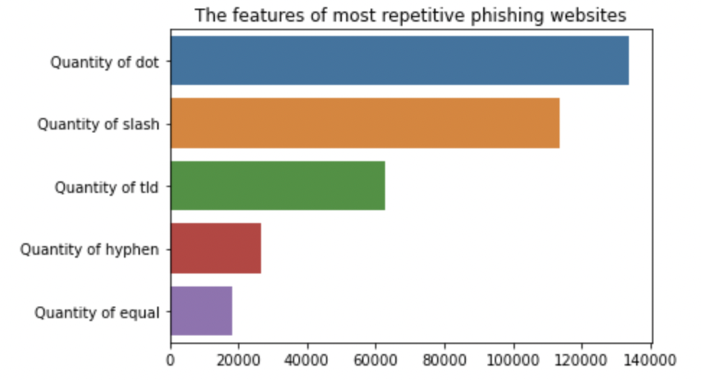
Visualization and Findings
Phishing Websites

Slide 16

Future Work
I want to see the correlation between the age of users, their cybercrime awareness, thier tech background, the type of device they usually use (Mobile/Laptop/PC), the type of operating system (macOS,Windows).
Group the most users who are likely to be vulnaruble then suggest a weekly short seissions for them in thier Work/Universty to raise their cybercrime awareness.

Slide 17
At Last but not least..
Thanks for listening..
Any Question

